Slide 1
Investigation of the PPO Algorithm for Autonomous Driving
Master’s Thesis Presentation
Kemal Acar
Supervisor:
Univ.-Prof. Dr.-Ing. Gerd Ascheid
Shawan Taha Mohammed M.Sc.

Slide 2
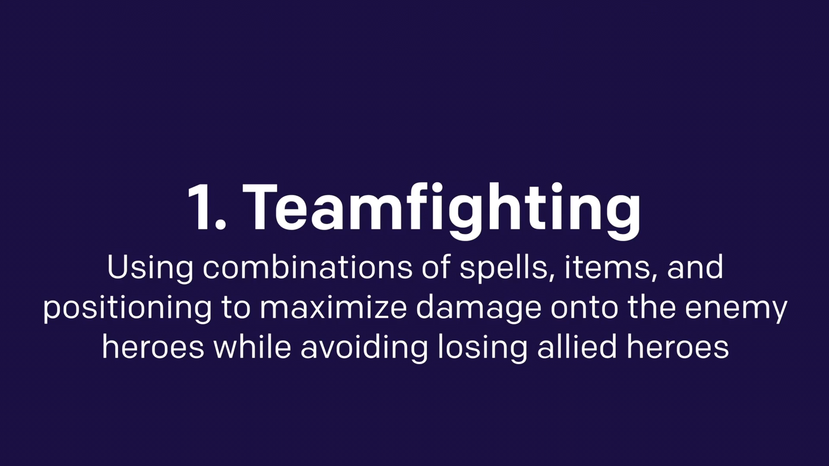
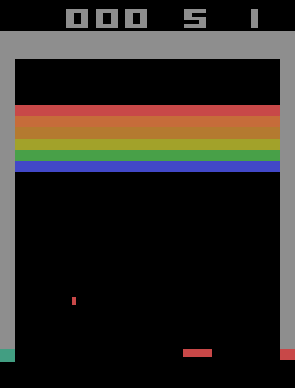
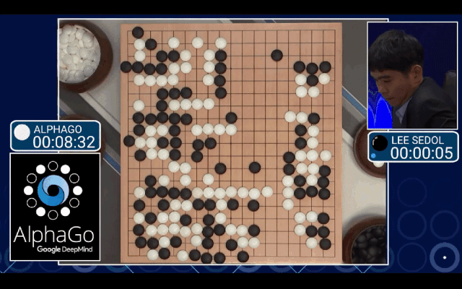
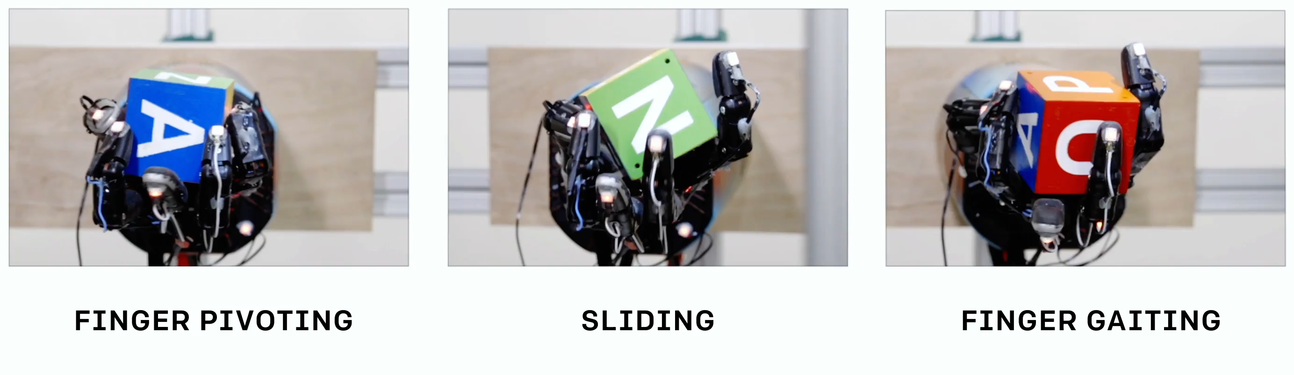
Motivation
DQN in Atari
Learning Dexterity
2015
2019
2013
2018
Alpha Go
OpenAi five

Slide 3
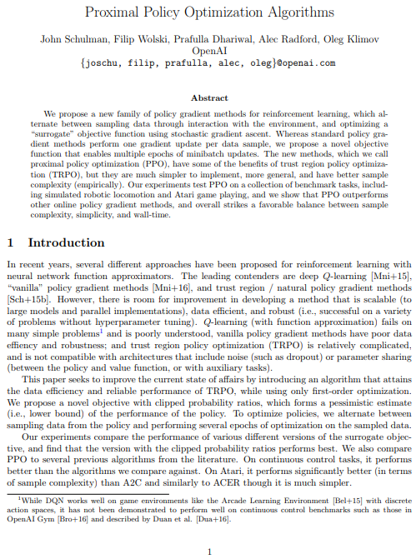

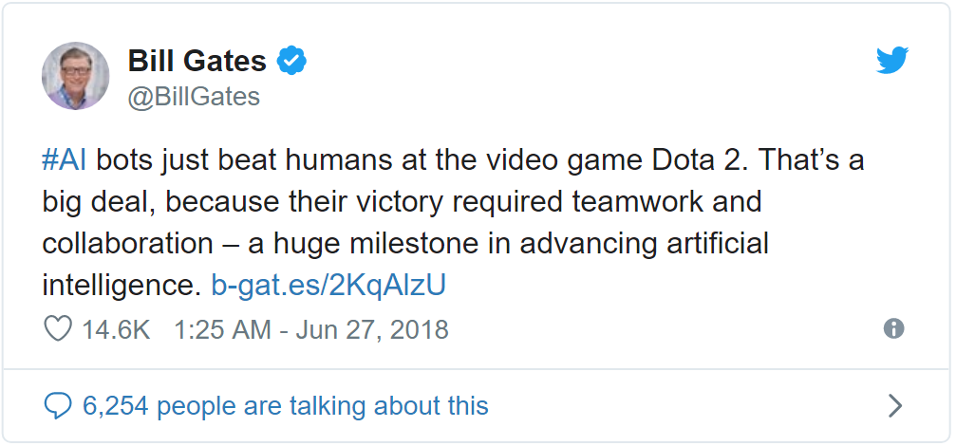
Motivation
OpenAI five
[1]
[2]
[3]

Slide 4
Agenda
Introduction
Reinforcement Learning
Environment
Methodology
Preprocessing
Network Architecture
Data Fusion for Deep Reinforcement Learning
Distributed and Parallel Learning
Results
Conclusion
Future Work

Slide 5
Agenda
Introduction
Reinforcement Learning
Environment
Methodology
Preprocessing
Network Architecture
Data Fusion for Deep Reinforcement Learning
Distributed and Parallel Learning
Results
Conclusion
Future Work

Slide 6
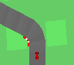

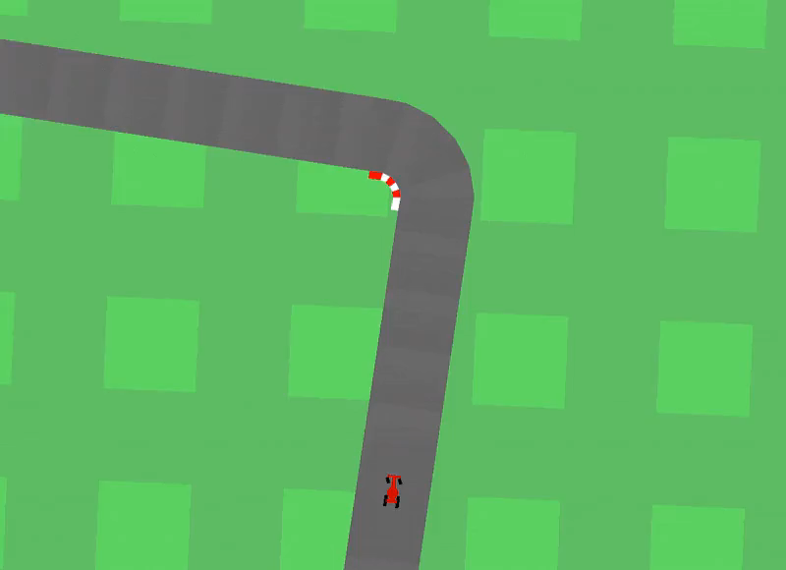
Reinforcement Learning
RL Fundamentals and the Environment
State
Environment
Agent
Reward
Action

Slide 7
Reinforcement Learning
Policy Gradient
Advantages of Policy Gradient Methods:
Better convergence properties
Better for high dimensional continuous action space
Policy gradient methods can learn a stochastic policy
The exploration/exploitation tradeoff is easier to solve
Perceptual aliasing is not a problem

Slide 8
Reinforcement Learning
Policy Gradient and Proximal Policy Optimization
Disadvantages of Policy Gradient Methods:
Poor sample efficiency
High variance
Big destructive gradient steps
PPO Countermeasure:
Importance sampling
Advantage function
Clipping of the loss function

Slide 9
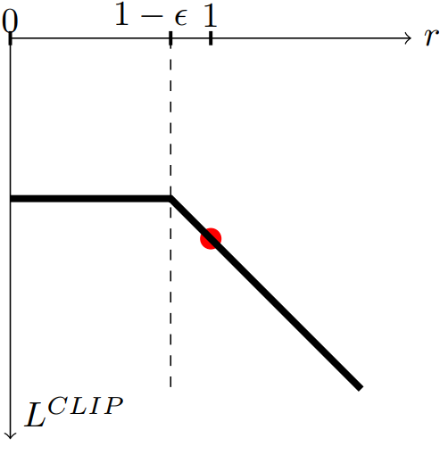
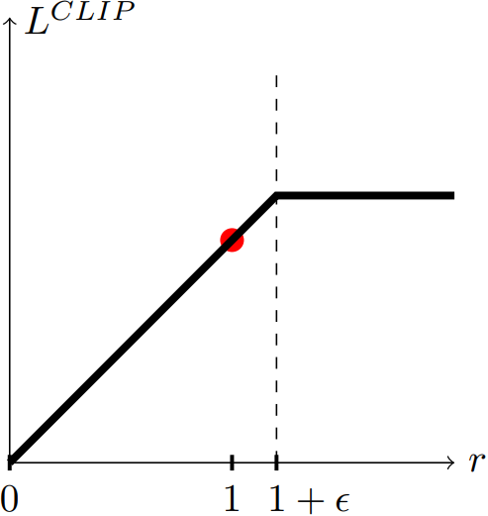
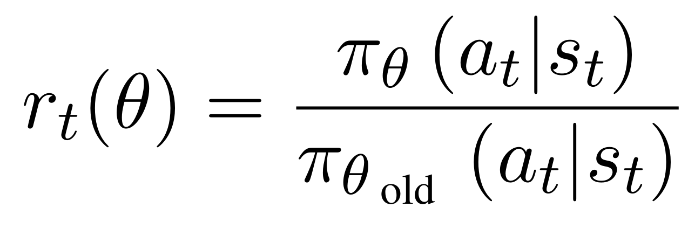
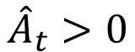
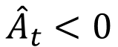
Reinforcement Learning
Proximal Policy Optimization
$${\hat{A}}_{t}<0$$
$${\hat{A}}_{t}>0$$
Actions yielded better than expected reward
Actions yielded worse than expected reward

Slide 10
Reinforcement Learning
Proximal Policy Optimization
$${\hat{A}}_{t}>0$$
Positive Advantage Estimate
Action is less probable in current policy than in the old policy.
Don’t clip and update the policy to increase the probability.
Actions yielded better than expected reward

Slide 11
Reinforcement Learning
Proximal Policy Optimization
$${\hat{A}}_{t}>0$$
Positive Advantage Estimate
Action is a bit more probable in current policy than in the old policy.
Don’t clip and update to increase the probability.
Actions yielded better than expected reward

Slide 12
Reinforcement Learning
Proximal Policy Optimization
$${\hat{A}}_{t}>0$$
Positive Advantage Estimate
Action is much more probable in current policy than in the old policy.
Clip the loss function to not increase the probability of that action too much.
Actions yielded better than expected reward

Slide 13
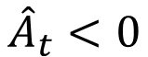
Reinforcement Learning
Proximal Policy Optimization
Negative Advantage Estimate
Action is much less probable in current policy than in the old policy.
Clip the loss function to not decrease the probability of that action too much.
$${\hat{A}}_{t}<0$$
Actions yielded worse than expected reward

Slide 14
Agenda
Introduction
Reinforcement Learning
Environment
Methodology
Preprocessing
Network Architecture
Data Fusion for Deep Reinforcement Learning
Distributed and Parallel Learning
Results
Conclusion
Future Work

Slide 15
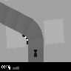
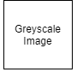
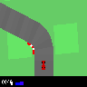
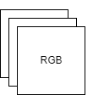

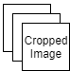
Methodology
Preprocessing

Slide 16
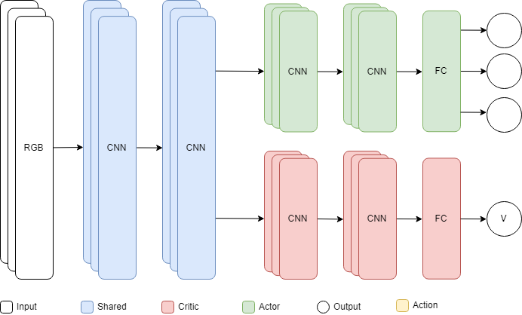
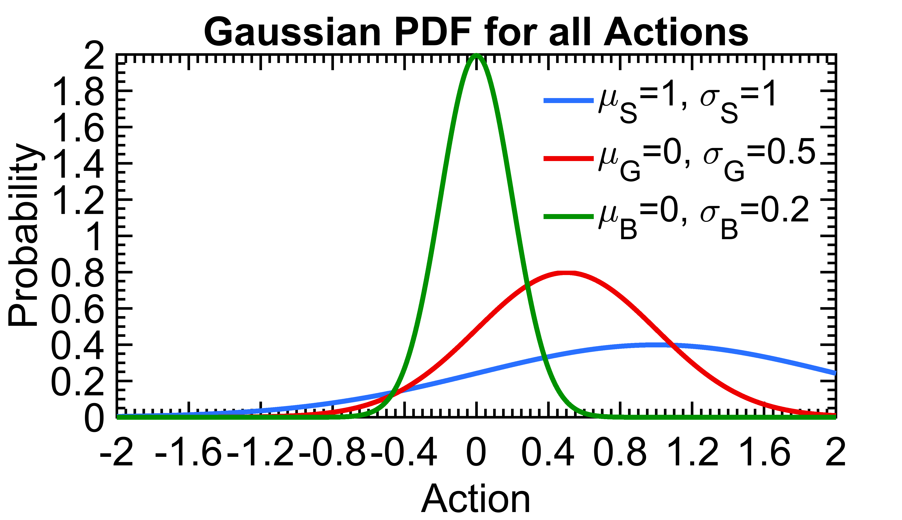
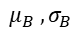
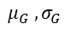
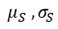
Methodology
Network Architecture
$$μ_{S} , σ_{S}$$
$$μ_{G} , σ_{G}$$
$$μ_{B} , σ_{B}$$
[1]

Slide 17
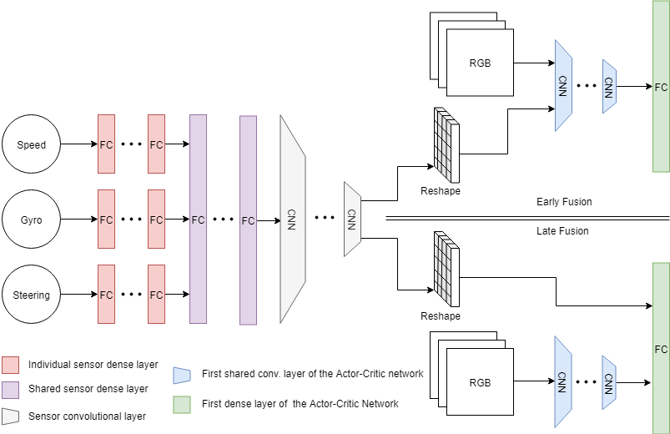
Methodology
Data Fusion

Slide 18
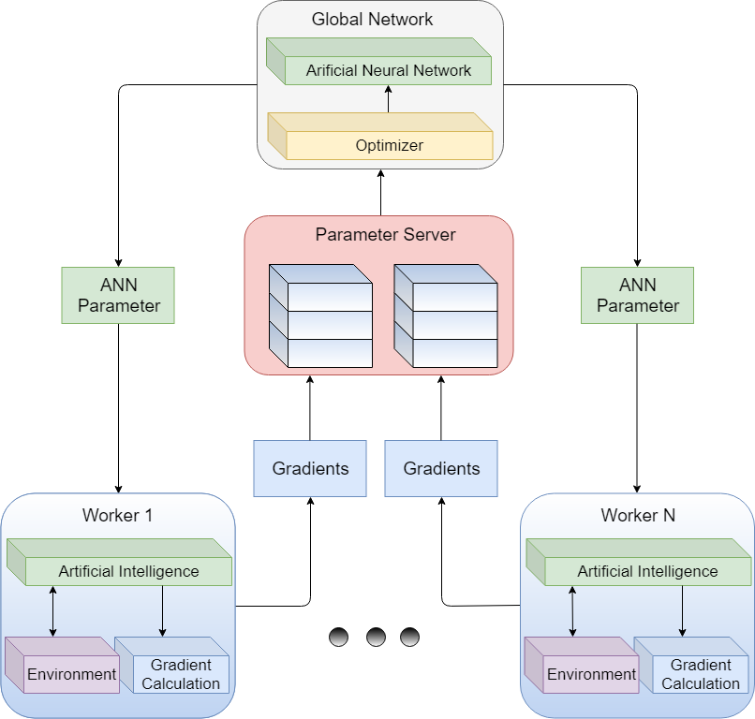
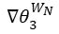
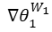
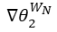
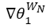
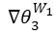
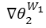
Methodology
Worker Framework
$${∇θ}_{1}^{W_{1}}$$
$${∇θ}_{1}^{W_{N}}$$
$${∇θ}_{2}^{W_{1}}$$
$${∇θ}_{2}^{W_{N}}$$
$${∇θ}_{3}^{W_{1}}$$
$${∇θ}_{3}^{W_{N}}$$
[1]

Slide 19
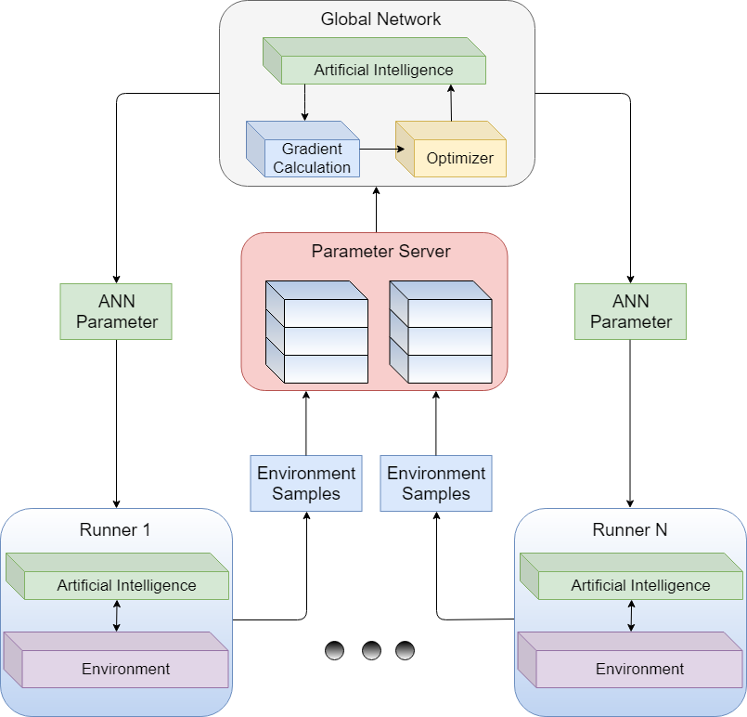
Methodology
Runner Framework
$$S_{1}^{R_{1}},A_{1}^{R_{1}},R_{1}^{R_{1}}$$
$$S_{1}^{R_{N}},A_{1}^{R_{N}},R_{1}^{R_{N}}$$
$$S_{2}^{R_{1}},A_{2}^{R_{1}},R_{2}^{R_{1}}$$
$$S_{2}^{R_{N}},A_{2}^{R_{N}},R_{2}^{R_{N}}$$
$$S_{3}^{R_{1}},A_{3}^{R_{1}},R_{3}^{R_{1}}$$
$$S_{3}^{R_{N}},A_{3}^{R_{N}},R_{3}^{R_{N}}$$
[1]

Slide 20
Agenda
Introduction
Reinforcement Learning
Environment
Methodology
Preprocessing
Network Architecture
Data Fusion for Deep Reinforcement Learning
Distributed and Parallel Learning
Results
Conclusion
Future Work

Slide 21
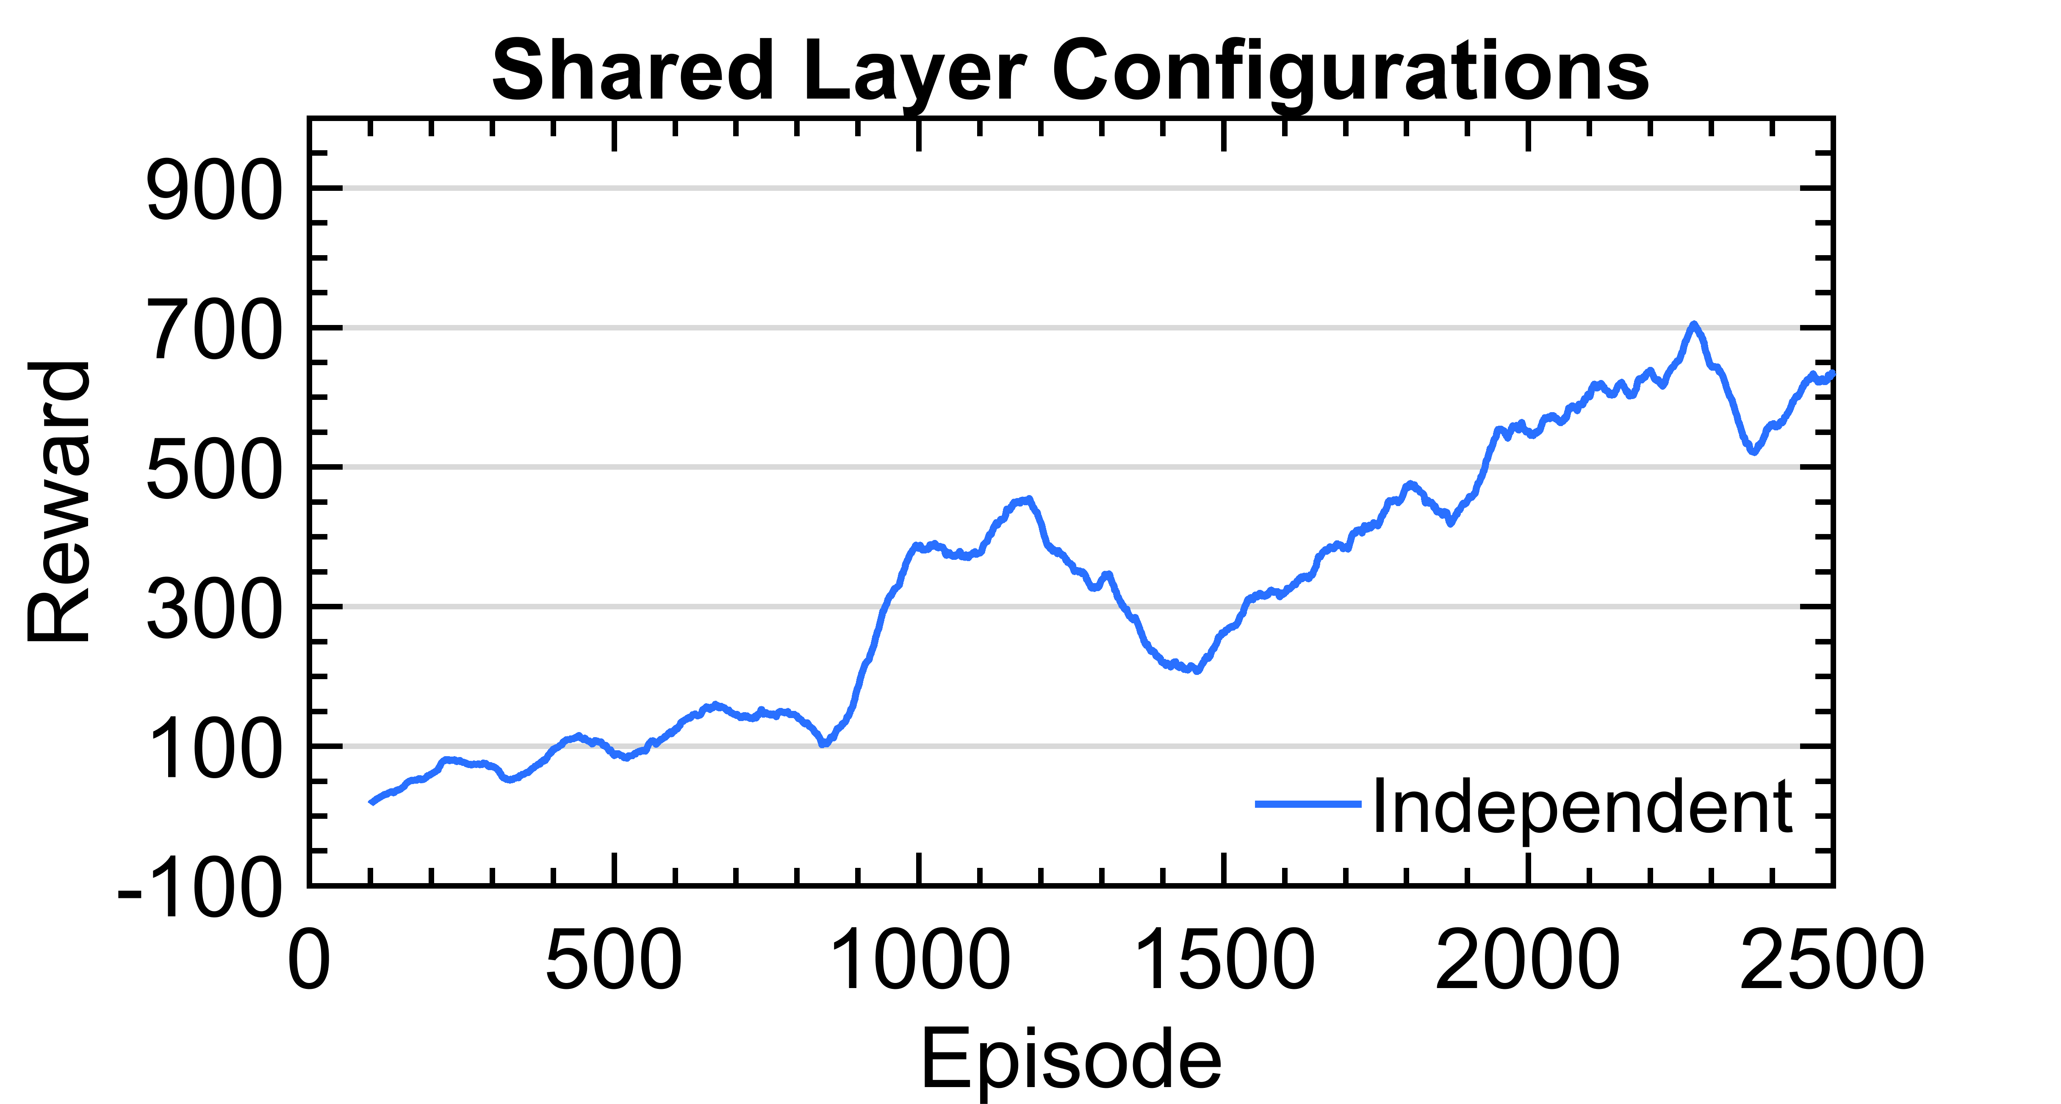
Results
Layer Sharing
Independent
Slow learning process
Steady increase in performance

Slide 22
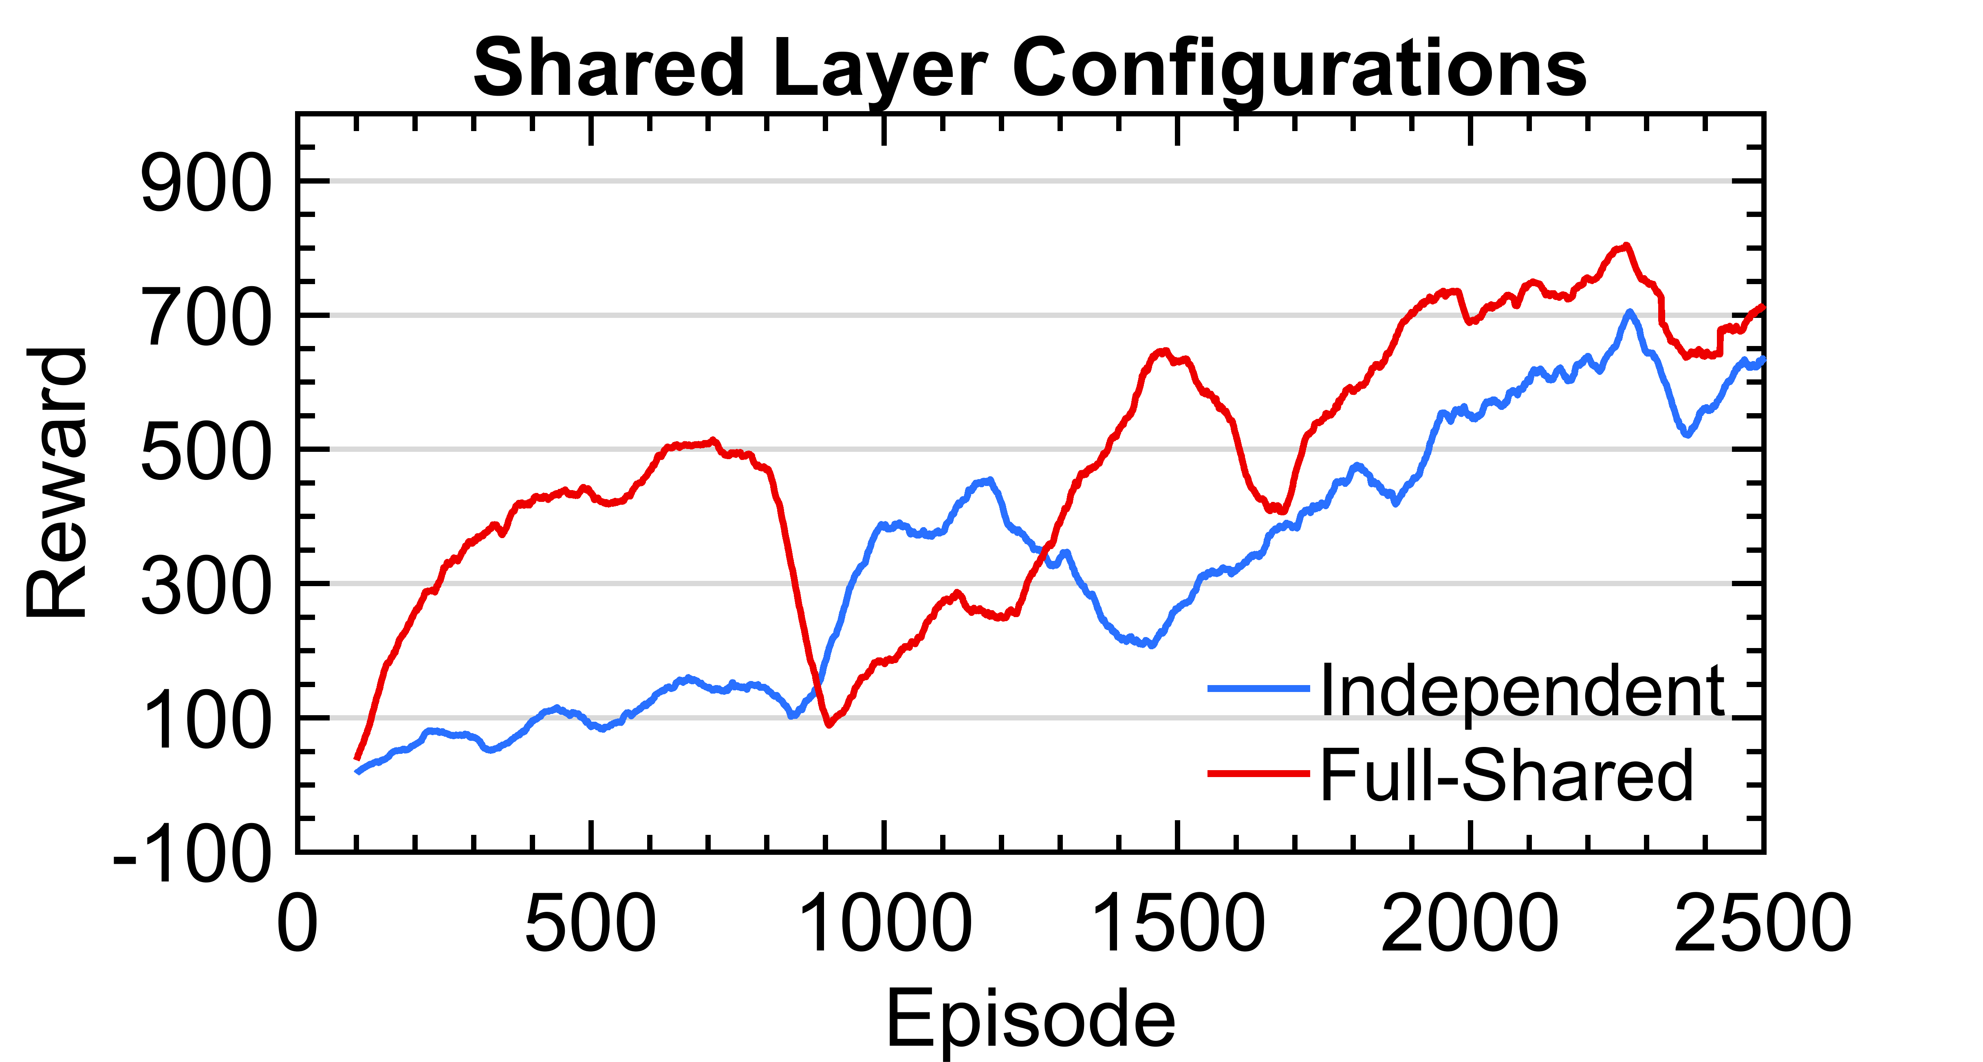
Results
Layer Sharing
Full-Shared
Faster increase
Major drop after 800 episodes

Slide 23
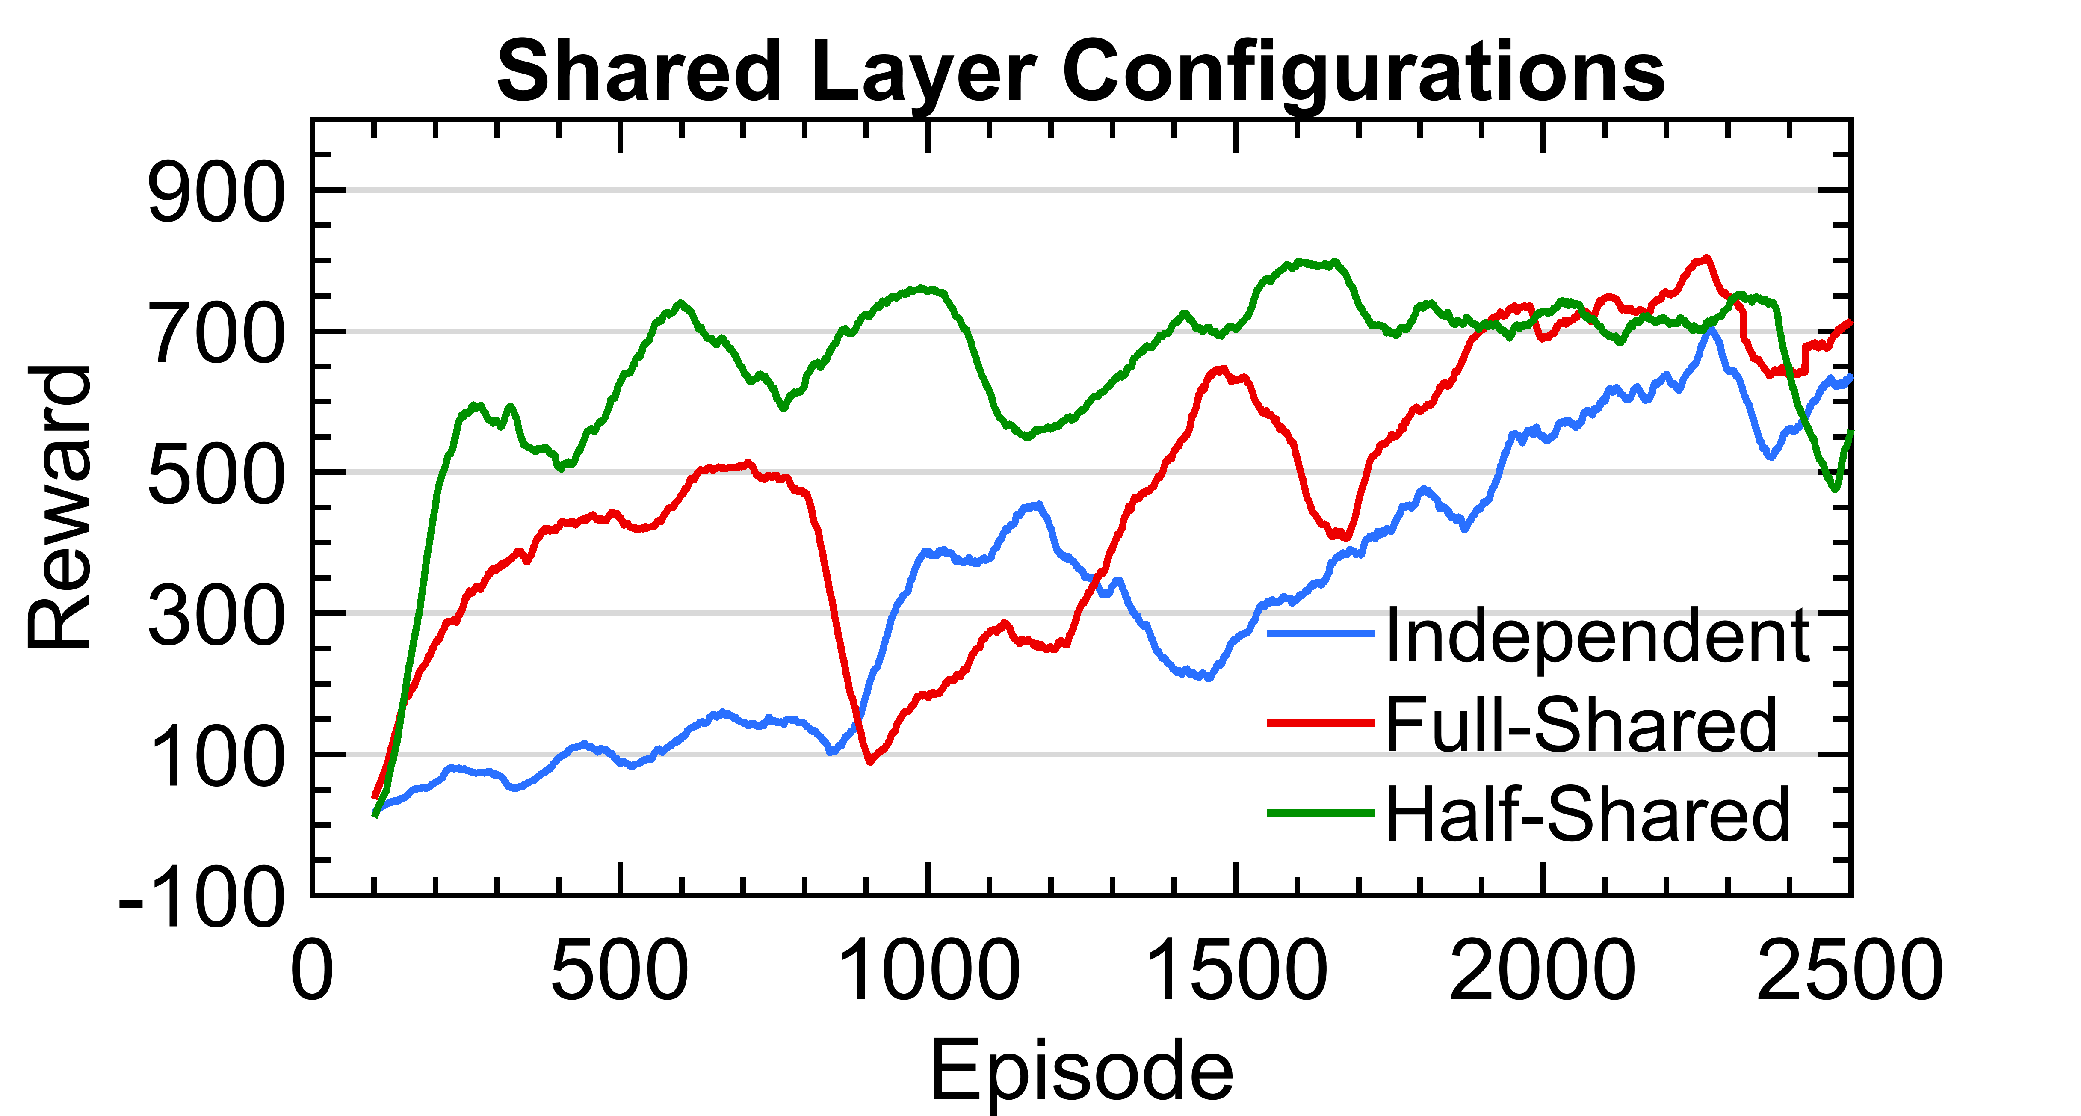
Results
Layer Sharing
Half-Shared:
Even faster performance increase

Slide 24

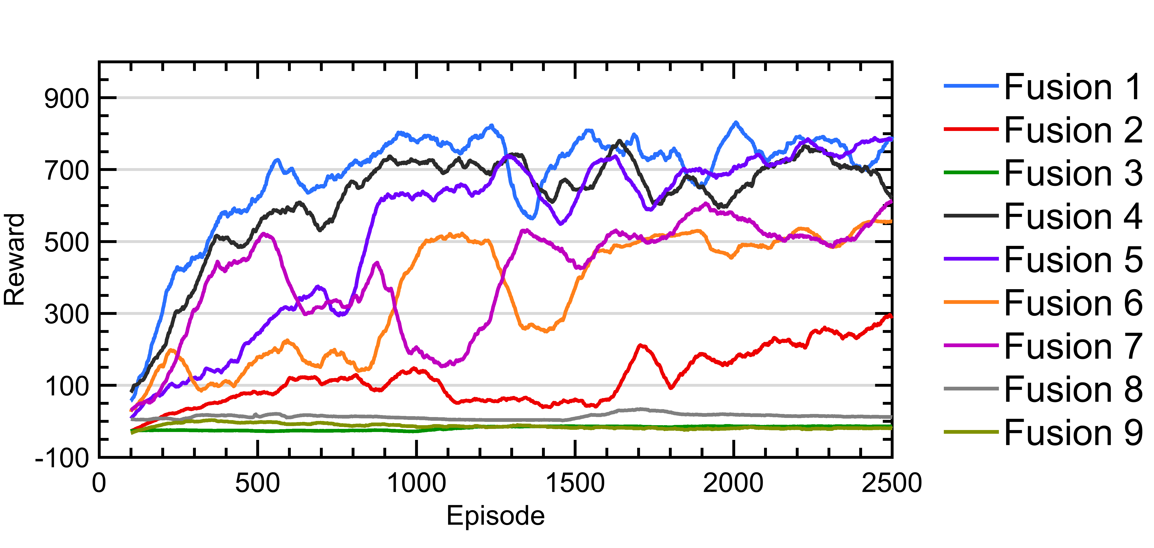
Results
Data Fusion
Individual Dense Layer
Reshape to Image Dimensions
Early Fusion

Slide 25
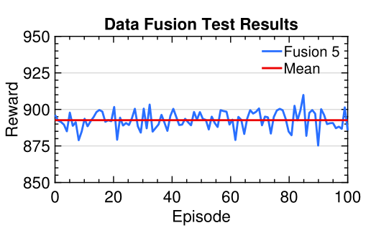
Results
Fusion Method 5
2 Individual dense layer for each sensor
Early Fusion with reshaped data
Mean reward of 892.63
Successfully finished all tracks
No drops under 875.25
Data Fusion

Slide 26
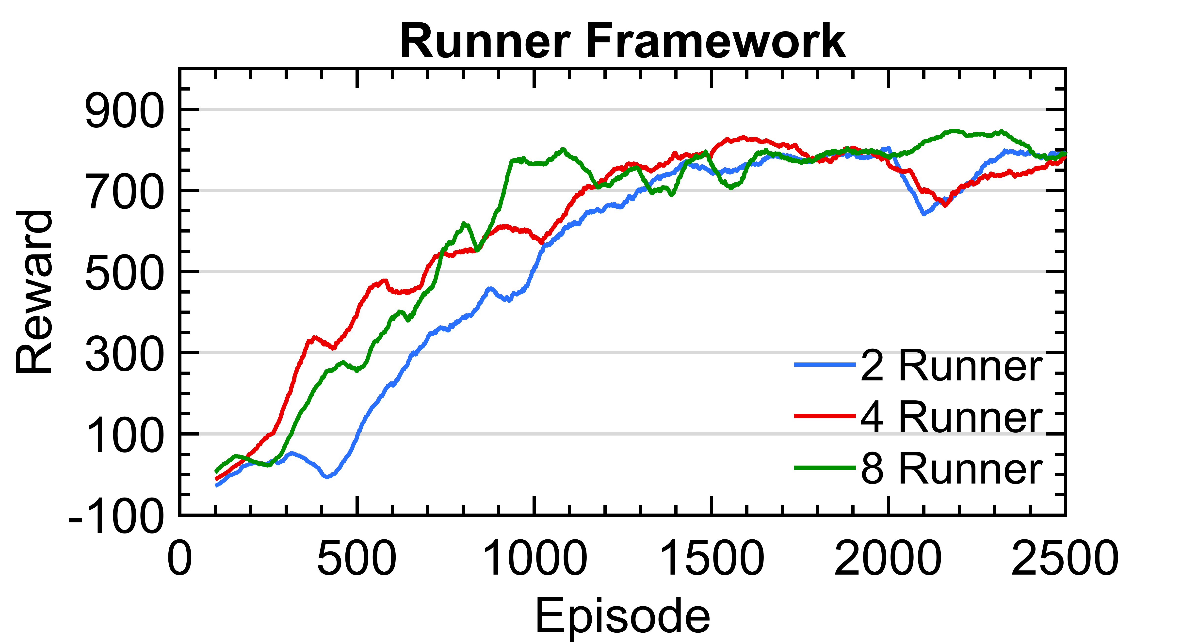
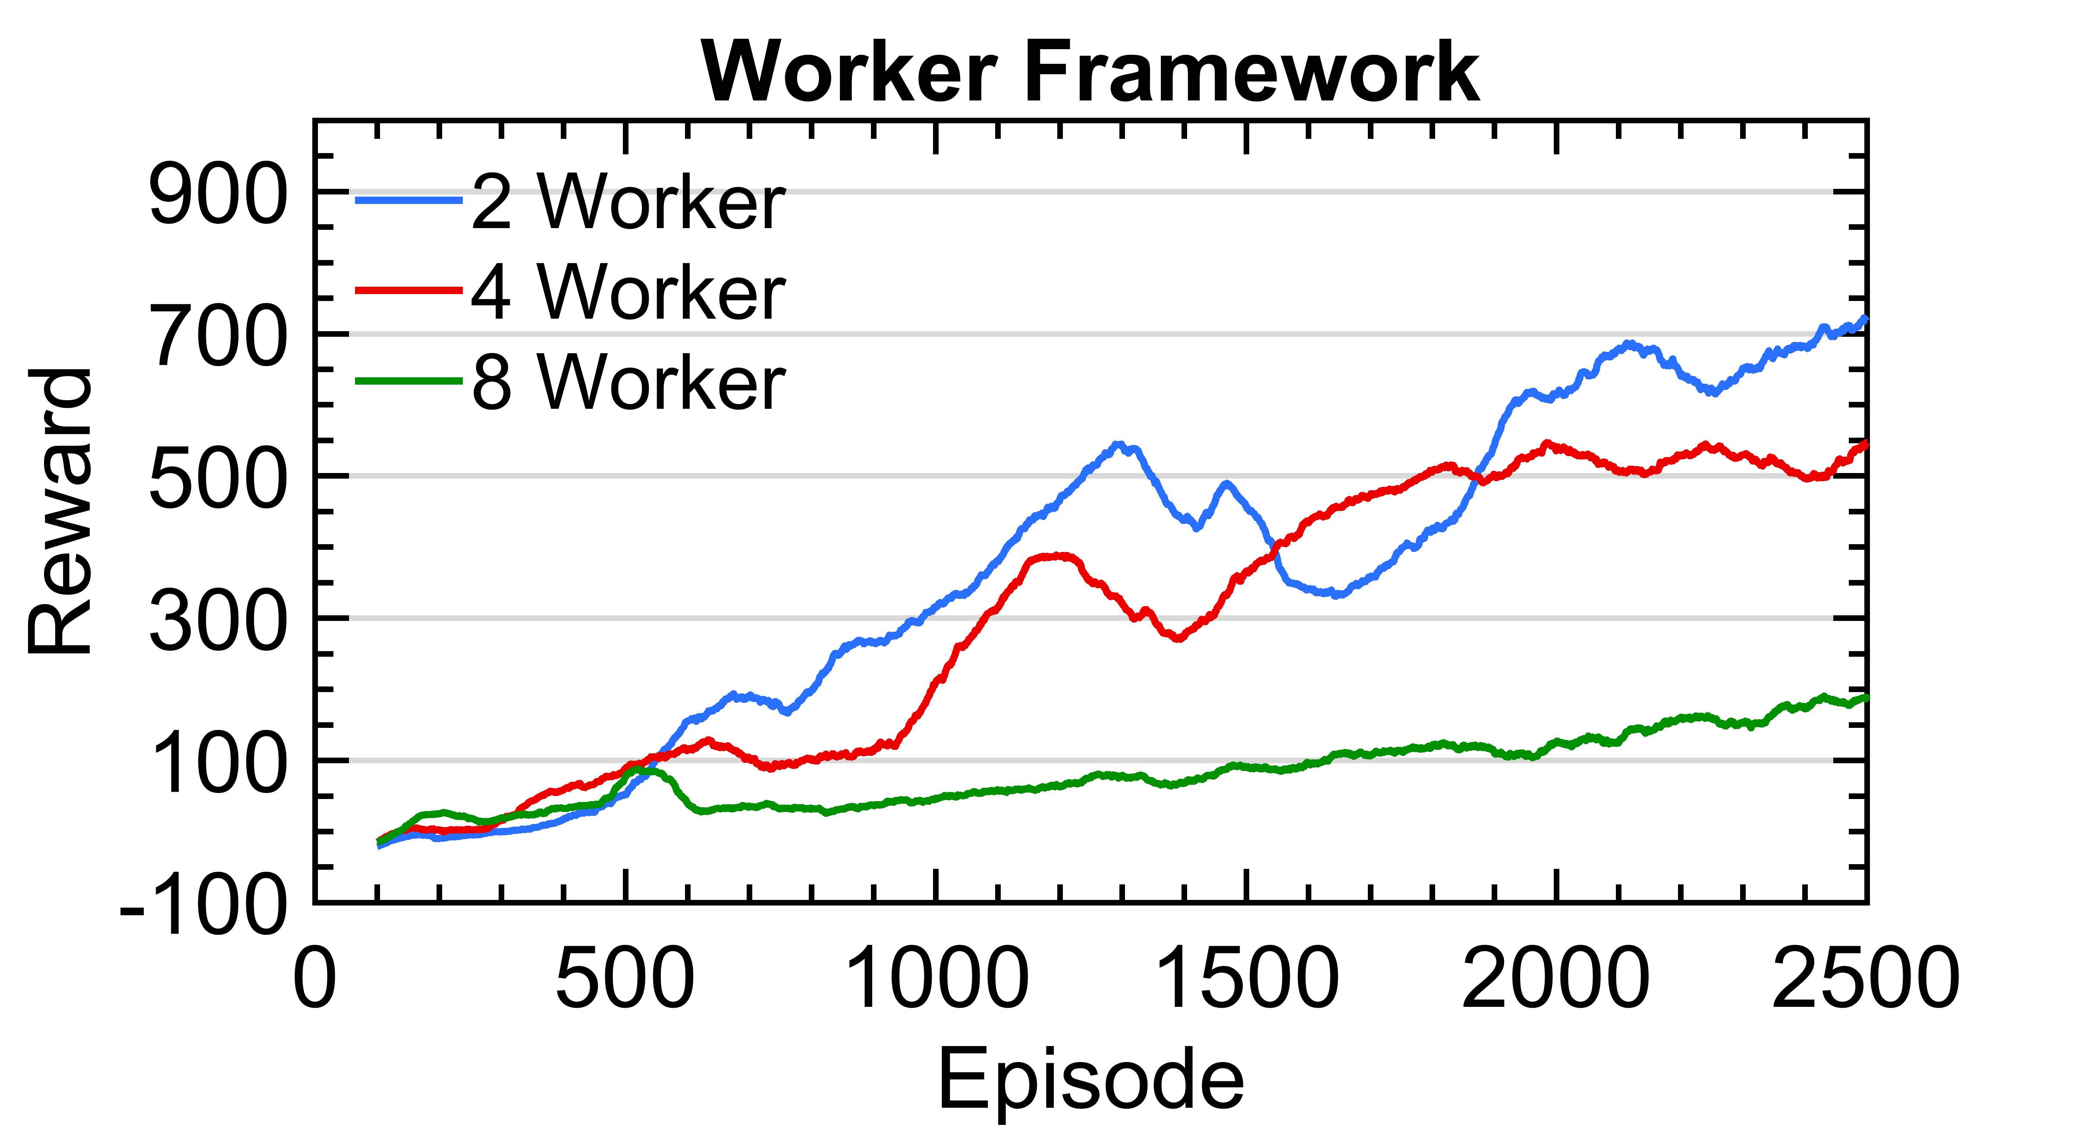
Results
Framework Comparison
Runner Framework
2 Workers ~ 5 hours
8 Workers ~ 2 hours
Worker Framework
Slow increase
Stale gradients

Slide 27
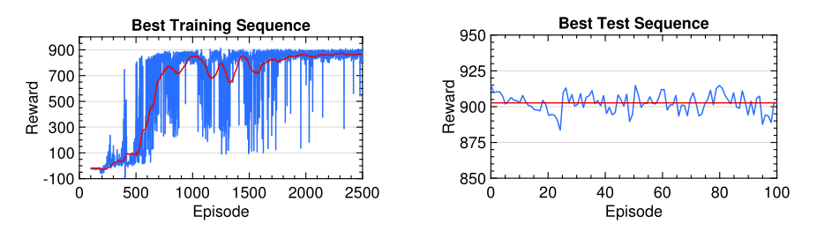
Results
Runner Framework
Training Sequence:
Batch size of 5 and 8 Workers
Great convergence behavior
Fast learning
Test Sequence:
Mean reward of 902
Solves the environment
No drops under 883.48

Slide 28
Agenda
Introduction
Reinforcement Learning
Environment
Methodology
Preprocessing
Network Architecture
Data Fusion for Reinforcement Learning
Distributed and Parallel Learning
Results
Conclusion
Future Work

Slide 29
Conclusion and Future Work
Conclusion
PPO achieves great performance even with minimal preprocessing.
Sharing half of the convolutional layer increases the learning speed and reduces the number of NN weights.
Data fusion for deep reinforcement learning is possible with:
Individual dense layer
Reshaping to the same dimensions of the image
Early fusion
The Runner-Framework performs better for the PPO algorithm.

Slide 30
Conclusion and Future Work
Future Work
More advanced simulation.
Methods to reduce the standard deviation on training sequences.
Research on reward shaping.
Using another probability density function for the continuous action space.
Synchronous framework for distributed learning

Slide 31
Thank you for your attention

Slide 32
Sources
[1] https://openai.com/five/
[2] https://twitter.com/BillGates
[3] https://arxiv.org/pdf/1707.06347.pdf
Appendix 1

Slide 33
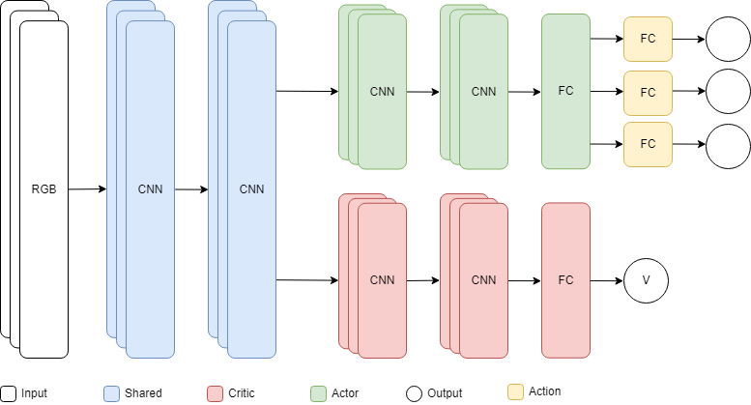
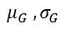
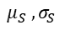
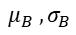
Implementation
Network Architecture
$$μ_{S} , σ_{S}$$
$$μ_{G} , σ_{G}$$
$$μ_{B} , σ_{B}$$
[1]

Slide 34
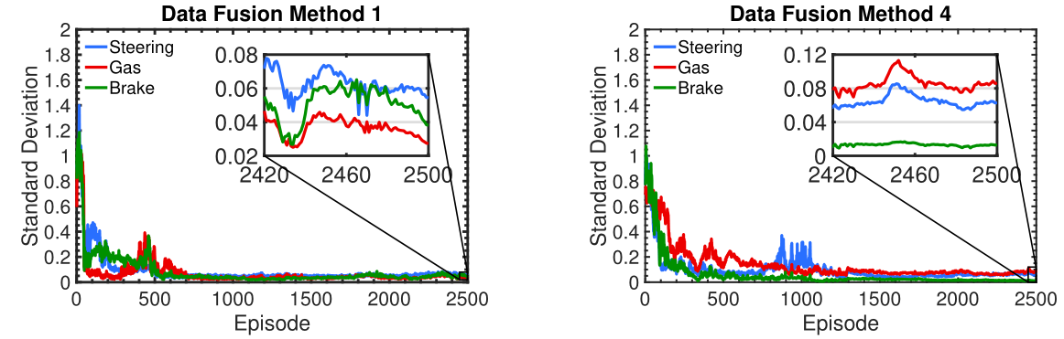
Results
Data Fusion

Slide 35
Reinforcement Learning
Proximal Policy Optimization
Negative Advantage Estimate
Action is much less probable in current policy than in the old policy.
Clip the loss function to not decrease the probability of that action too much.
$${\hat{A}}_{t}<0$$
Actions yielded worse than expected reward

Slide 36
Reinforcement Learning
Proximal Policy Optimization
Negative Advantage Estimate:
Action is much more probable in current policy than in the old policy.
Don’t clip and undo the last gradient step to decrease the probability of the action.
$${\hat{A}}_{t}<0$$
Actions yielded worse than expected reward

Slide 37
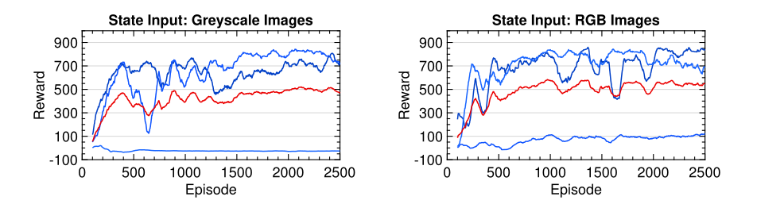
Results
Preprocessing
Blue lines: Training sequences
Red line: Mean of the training sequences
Randomness induced by:
Initial neural network weights
Action sampling
Random track generation
[1]

Slide 38
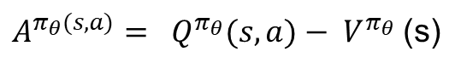
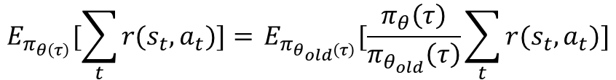
Reinforcement Learning
Policy Gradient and Proximal Policy Optimization
Disadvantages of Policy Gradient Methods:
Poor sample efficiency due to it’s on-policy nature
High variance
Big destructive gradient steps
PPO Countermeasure:
Importance sampling
Advantage function
Clipping of the loss function
$$E_{π_{θ\left(τ\right)}}[\sum_{t}{r(s_{t},a_{t})]= }E_{π_{θ_{old}\left(τ\right)}}[\frac{π_{θ}\left(τ\right)}{π_{θ_{old}}\left(τ\right)}\sum_{t}{r(s_{t},a_{t})]}$$
$A^{π_{θ}(s,a)}= Q^{π_{θ}}(s,a)− V^{π_{θ}}$(s)
$$L^{CLIP}\left(θ\right)=Ê_{t}[\min\left(\frac{π_{θ}\left(τ\right)}{π_{θ_{old}}\left(τ\right)}Â_{t}, clip\left(\frac{π_{θ}\left(τ\right)}{π_{θ_{old}}\left(τ\right)},1−ϵ,1+ε\right)Â_{t}\right)]$$

